Slide 1




Data-Limited Fisheries Toolkit
Evaluating management strategies for data-limited fish species
The format of data for DLMtool
Lecture 4a, May 2017
Tom Carruthers & Adrian Hordyk .
Nicolas Gutierrez

Slide 2
Agenda
Time series data
Parameters
Uncertainty

Slide 3
A standardized data format
Real fishery / sampling
Simulation (the observation model of an MSE)
Data
Management Procedure
Recommendation

Slide 4
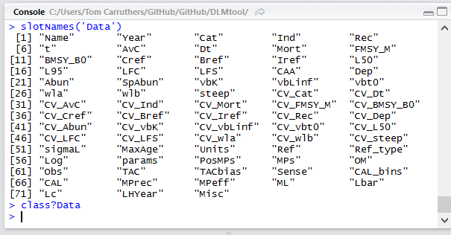
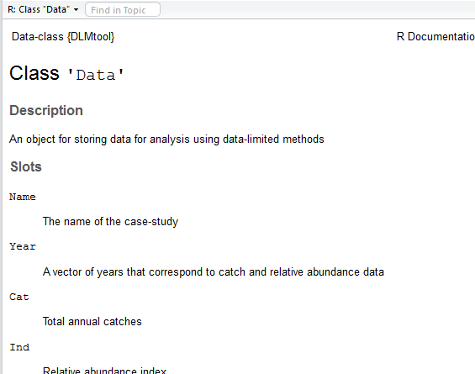
The ‘Data’ class
DLMtool data are stored in an object of class ‘Data’
Like all classes in DLMtool you can get a summary of what it contains (its slots) using the function slotNames().

Slide 5
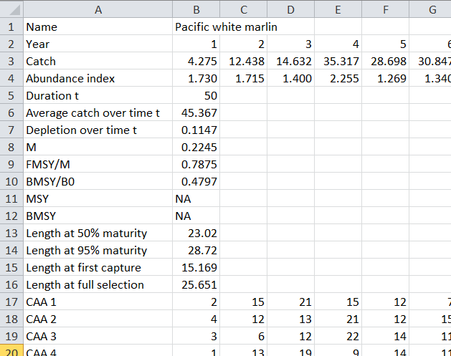
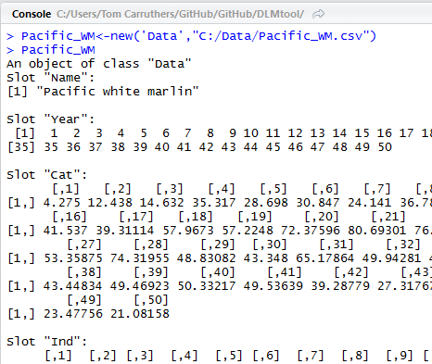
Another class, another CSV

Slide 6
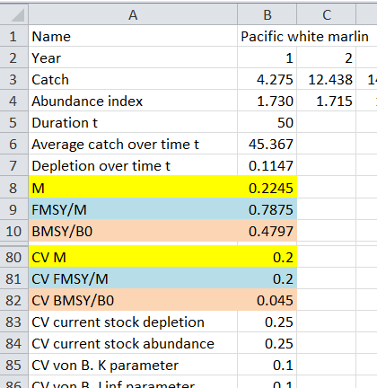
Parameters and uncertainty
Current dealt with quite simply:

Slide 7
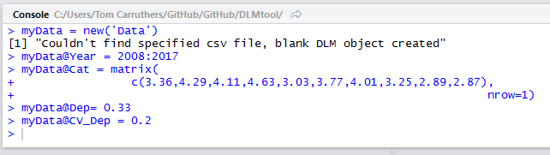
Without a CSV
Just like the Stock, Fleet, Obs and Imp objects, blank objects of class Data can be created in an R session and filled using data available in the R session.
Just use the new() function without specifying a csv file:

Slide 8
Getting help with Data objects
Cheat sheets for objects: /Help/Cheat sheets/
Examples: /Exercises/Data/CSV/Data_example.csv
R package help: class?Data
Online help: https://dlmtool.github.io/DLMtool/index.html

Slide 9
Recap: DLMtool objects
Stock Stock dynamics
Fleet Fleet dynamics
Obs Observation error model
Imp Implementation error model
OM Operating model (Stock, Fleet, Obs, Imp combined)
MSE An MSE object from runMSE()
Data An object contain real (or simulated in runMSE) data

